Slide 1
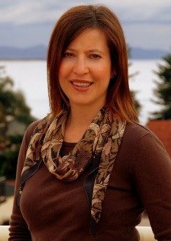
Debra Z. Basil, PhD
Professor of Marketing
Markin Hall 4016
(403) 329-2164
Debra.basil@uleth.ca
Please see my webpage on scholar.ulethbridge.ca

